Slide 1
OCT diagram
Stephan
2018/09/23

Slide 2
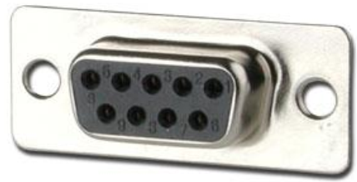
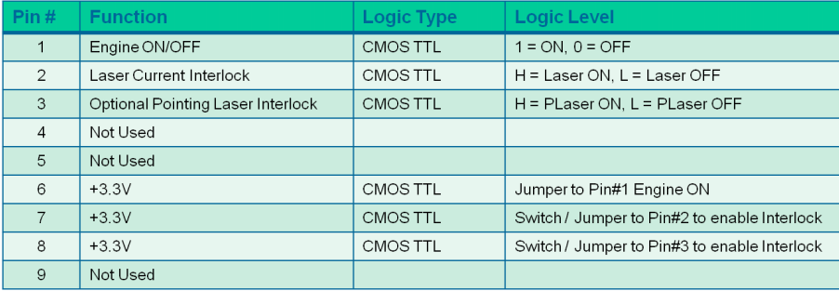
100-240V AC
Power
Axsun interlock Pins
Laser
1
Axsun
2
Interlock
3
3.3V
6
OCT signal1
3.3V
7
BD1
3.3V
8
OCT signal2
computer
OCT signal3
USB
BD2
OCT signal4
Sweep
trigger
K-clock
Ch1
Ch2
0-1.2V TTL
100KHz
0-0.8V
1376 Sample
/310MHz
Sweep
trigger
K-clock
Ch1
Ch2
Alazar
DAQ
computer
DI/O
trigger
Laser & digitizer circuit | Draw by Stephan C | Check by | 09/24/18 | Sheet no. 1

Slide 3
1
Galvo
Driver1
GVS001
+15V
1
J9
Moter1
Gnd
J10
-15V
2
3
8
1
J6
diagnose
DAQ
J7
Feed back
AO1
JP4
8
1
8
1
3
2
AI
computer
card
Galvo
Driver2
GVS001
AI
+15V
1
J9
Moter2
Gnd
J10
-15V
2
3
DI
AO2
J6
diagnose
JP4: configure external enabling by placing a jumper across pin2 and pin3 in JP4, then use pin4 in J7 as ON/OFF. No signal and plus signal is considered ON, while minus signal is considered OFF
J7
JP4
1
8
1
3
2
digitizer
J7 Pin# | 1 | 2 | 3 | 4 | 5 | 6 | 7 | 8
Function | Command Input +v [-10V,10V] | Command Input -v | Not used | External Enable | -12V Output | +12V Output | Ground | Ground
Trigger
DAC & Galvo circuit | Draw by Stephan C | Check by | 09/24/18 | Sheet no. 2

Slide 4
100-240VAC
Position error*5
ON/OFF
1
Power
Laser
Command signal
Laser current
Axsun
Pointing laser ON/OFF
Interlock
2
3
1
J6
8
Galvo
Driver1
GVS001
transmitters
OCT signal4
JP4
3.3V
Power
supply
3.3V
8
OCT signal3
+15V
1
3.3V
BD1
Gnd
J10
-15V
2
Motor1
BD2
OCT signal2
3
J9
USB
OCT signal1
K-clock
0-0.8V
Sweep
Trigger
0-1.2V
100kHz
1
J7
8
Ch1
Ch2
AO
NI
DAQ
Alazar
trigger
AO
PCIe bus
DI/O
AI
Position error*5
computer
DI
AI
Command signal
AI
AI
2
3
1
J6
8
AI
Galvo
Driver2
GVS001
PCIe bus
AO
JP4
Power
supply
DO
AO
+15V
1
DO
DO
Gnd
J10
-15V
2
Motor2
Laser
energy
3
J9
1
J7
8
detector
OCT wiring diagram | Draw by Stephan C | Check by | 09/24/18 | Sheet no. 1

Slide 5
100-240VAC
Position error*5
ON/OFF
1
Power
Laser
Command signal
Laser current
Axsun
Pointing laser ON/OFF
Interlock
2
3
1
J6
8
X-Galvo
Driver
GVS001
transmitters
OCT signal4
JP4
3.3V
Power
supply
3.3V
8
OCT signal3
+15V
1
3.3V
BD1
Gnd
J10
-15V
2
Motor-X
BD2
OCT signal2
3
J9
USB
OCT signal1
K-clock
0-0.8V
Sweep
Trigger
0-1.2V
100kHz
1
J7
8
Ch1
Ch2
AO
X
DAQ
Alazar
trigger
AO
PCIe bus
DI/O
AI
computer
DI
AI
DO
DO
Position error*5
PCIe bus
Command signal
trigger
2
3
1
J6
8
PCIe bus
Y-Galvo
Driver
GVS001
JP4
Power
supply
DI
AO
+15V
1
Y
DAQ
Gnd
J10
AO
-15V
2
Motor-Y
AI
3
J9
AI
DO
DO
1
J7
8
DO
DO
AI
Laser
energy
detector
OCT wiring diagram | Draw by Stephan C | Check by | 09/24/18 | Sheet no. 1

Slide 6
GVS001 Galvo J6 diagnostic Pins configuration
J6 Pin# | 1 | 2 | 3 | 4 | 5 | 6 | 7 | 8
Function | Scanner Position | Internal Command Signal | Positioning Error x 5 | Motor Drive Current | Not used | Test Input (NC) | Motor + Coil Voltage / 2 | Ground
Meaning | Proportional to the position of scanner mirror, scaled by 0.5 | The input voltage, scaled by 0.5 | (Pin1-Pin2)*5 | The drive current of the motor(2V per A) |  |  | The drive voltage to the “+” side of the motor coil. Scaled by 0.5. The drive voltage determines the current, the current determines the acceleration of motor.
J9 Pin# | 1 | 2 | 3 | 4 | 5 | 6 | 7 | 8
Function | Position Sensor A Current | Position Sensor Ground | Position Sensor Cable Shield | Drive Cable Shield | Position Sensor B Current | Position Sensor Power | Motor + Coil | Motor -Coil
J7 Pin# | 1 | 2 | 3 | 4 | 5 | 6 | 7 | 8
Function | Command Input +v [-10V,10V] | Command Input -v | Not used | External Enable | -12V Output | +12V Output | Ground | Ground
GVS001 Galvo Pins | Draw by Stephan C | Check by | 09/24/18 | Sheet no. 2

